Slide 1
Get-Off
Get fed up using your phone!
M M Kishore
Tarshit V
Kamaleshen S

Slide 2
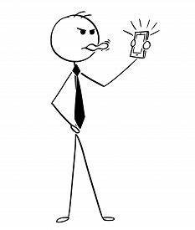
Project objective
Disconnect from your phone as quickly as possible.

Slide 3
Contents
Understanding the problems
Our Solution
Current Market Trends vs Ours
3 Modes
Target Audience
Our workflow
Revenue

Slide 4
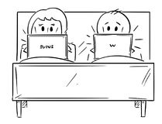
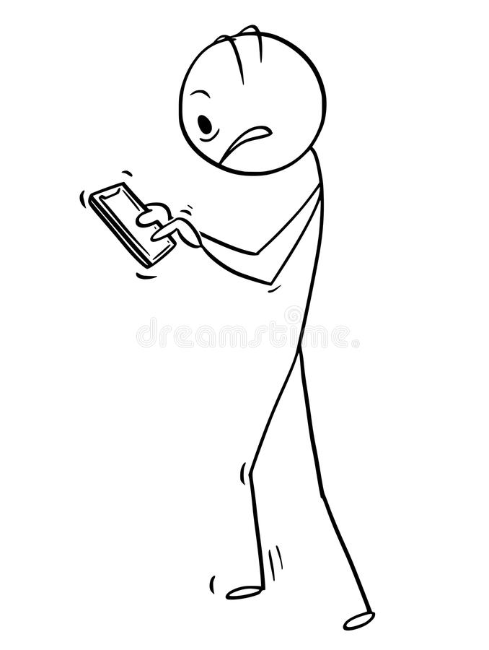
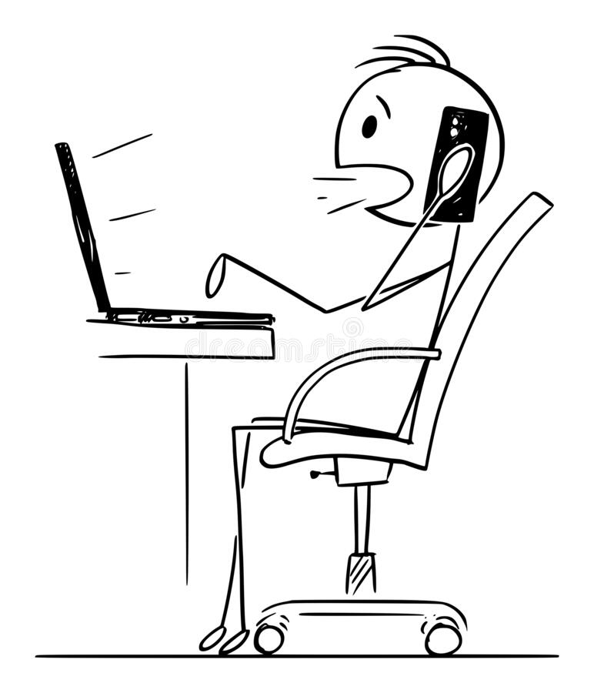
Understanding the problems
Online classes and work from home jobs have made laptops and mobiles as out friends.
01
The relationship between a person and his phone is getting stronger than real human relationships.
02
Though a lot of us are productive in the school/office but we still lack productivity in maintaining our relationships with our family and friends.
03

Slide 5
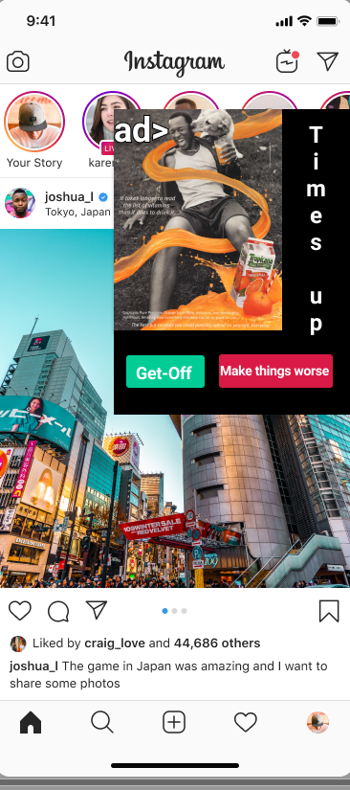
Our Solution
A growing floating window pops up restricting the normal view after the time is up.
It grows more and more until the person stops using his phone

Slide 6
Current Market Trends vs Ours
Traditional apps shuts the phone or app abruptly without much of a notification. But ours is going to be a step by step process(growing floating window)
Traditional Apps
Get-Off
100%
100%
80%
80%
60%
60%
Phone usage
Phone usage
40%
40%
20%
20%
0%
0%
T1
T2
T3
T4
T1
T2
T3
T4
Time
Time

Slide 7
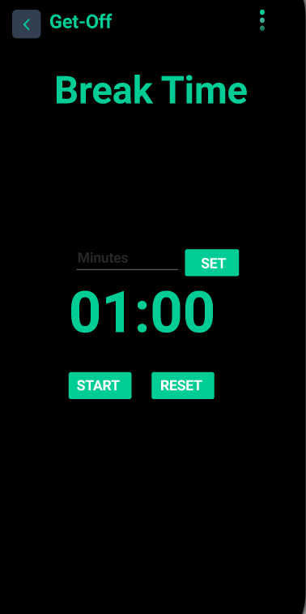
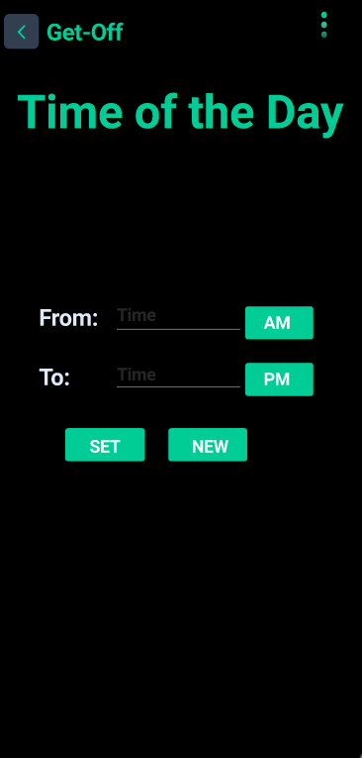
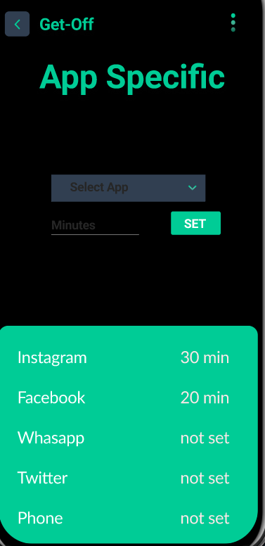
3 Modes
Customers can choose from 3 different mode depending on their preferences
Break Time
Time of the day
App Specific

Slide 8
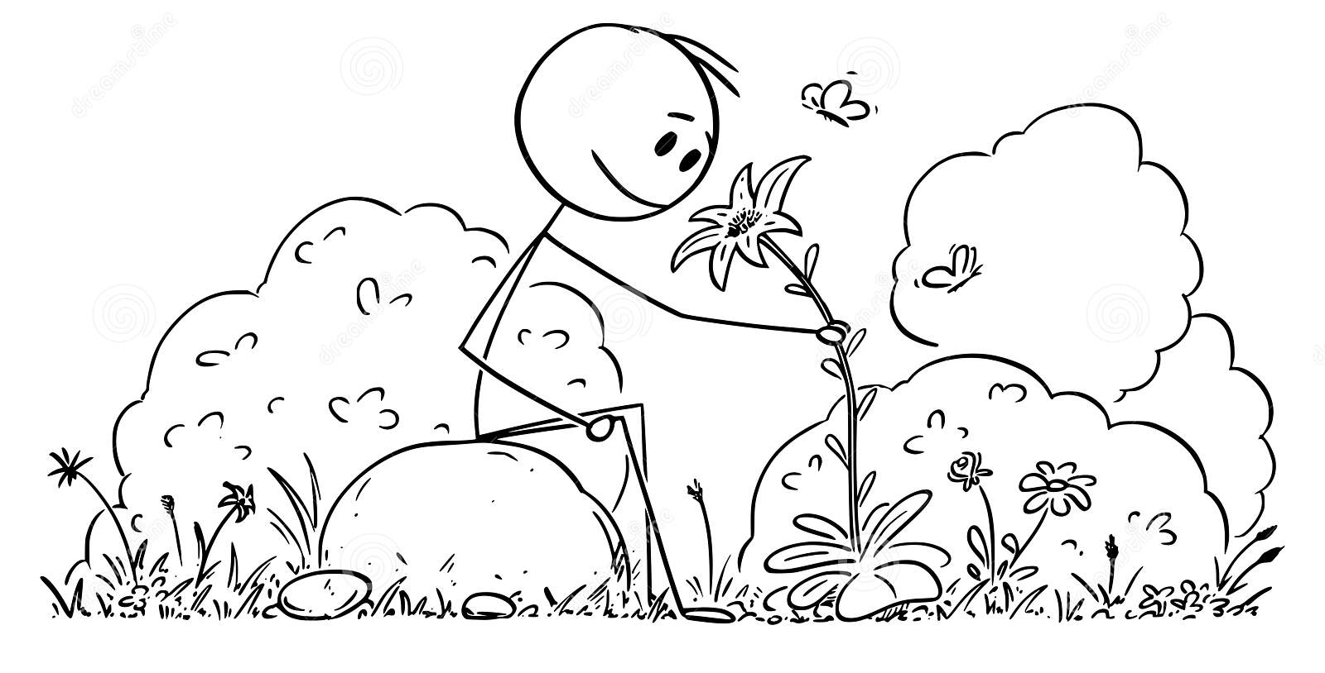
Target audience
Anyone who wish to:
Spend their quality time with their loved ones.
Stop Mindless Scrolling Habit.
Become more productive by getting some time off.

Slide 9
Our Workflow
4
Prototype
Refine
The app design and basic look and feel
Making further improvements to the app from feedback and implement future ideas
1
3
Share
Get feedback
Upload it on Google Play store for maximum reach and promoting on social media.
Get Feedback from user via playstore and in app feedback service
2

Slide 10
Revenue
Ads displayed on the floating pop up window
Paid Pro- Membership(Includes no ads, status check)

Slide 11
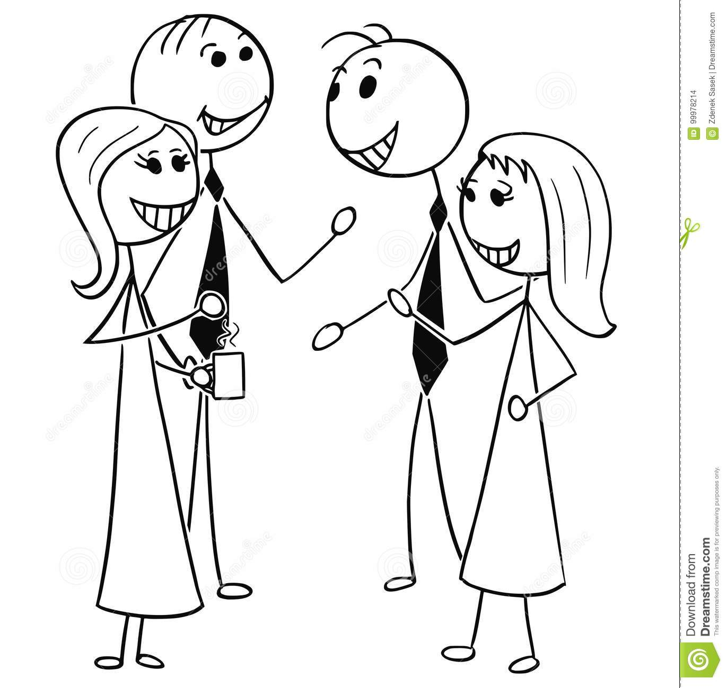
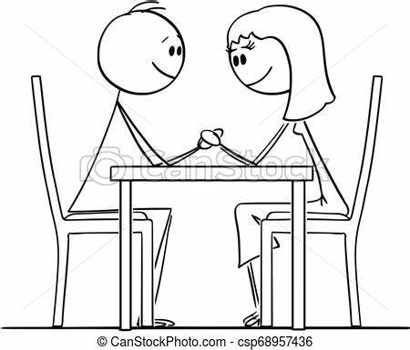
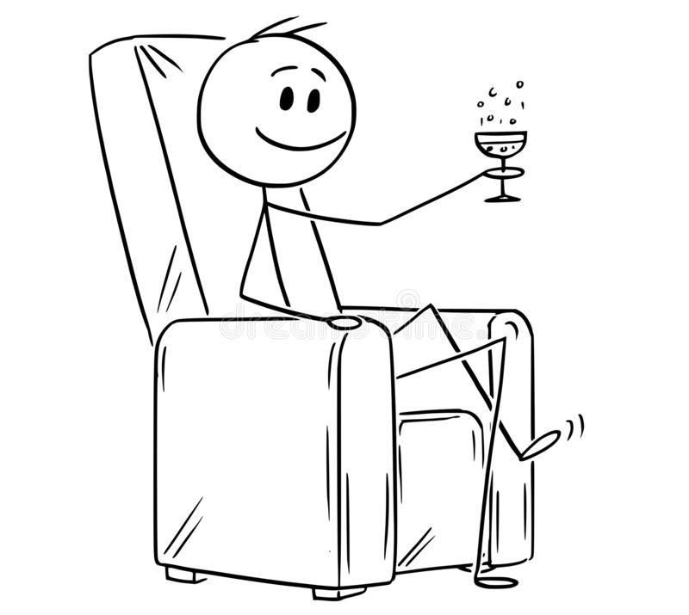
Thank You !
Let us gain control over our precious life !

